Slide 1
Teacher Librarian Scholarship presented to
Erin Ell
Palm Springs Unified School District
Nellie N. Coffman Middle School
California State University Long Beach Student

Slide 2
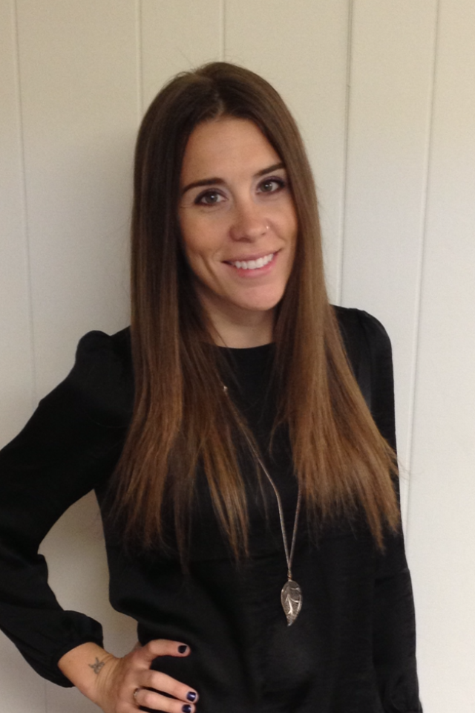
“Her energy, attitude, and expertise have changed the library’s climate.”
-Lucinda Killebrew
Nellie N. Coffman Middle School
Palm Springs USD

Slide 3
She has been “recognized by her peers as Teacher of the Year”
-Lucinda Killebrew, Principal
Nellie N. Coffman Middle School
Palm Springs USD

Slide 4
Erin leads “... book and technology clubs that target even the non-reader.”
-Lucinda Killebrew, Principal
Nellie N. Coffman Middle School
Palm Springs USD

Slide 5
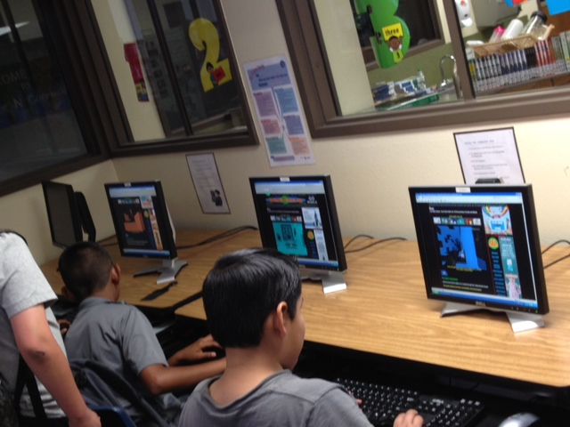
Erin leads “.. book and technology clubs that target even the non-reader.”
-Lucinda Killebrew, Principal
Nellie N. Coffman Middle School
Palm Springs USD

Slide 6
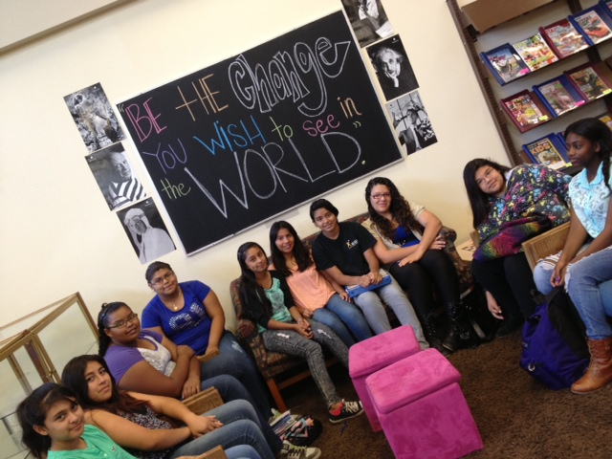
She has “made the library a coveted place to be for teachers and students.”
-Lucinda Killebrew, Principal
Nellie N. Coffman Middle School
Palm Springs USD

Slide 7
“Erin is enthusiastic and forward thinking.”
Dr. Lesley S. J. Farmer
Professor of Library Media
CSU Long Beach

Slide 8
“She is seen as her school’s technology expert.”
Dr. Lesley S. J. Farmer
Professor of Library Media
CSU Long Beach

Slide 9
“She drives hours for class, even on weekdays (she works in the Palm Springs area and commutes to class in Long Beach) .”
Dr. Lesley S. J. Farmer
Professor of Library Media
CSU Long Beach

Slide 10
“She provides many opportunities for her students to engage and contribute to the library program.”
Dr. Lesley S. J. Farmer
Professor of Library Media
CSU Long Beach

Slide 11
Teacher Librarian Scholarship presented to
Erin Ell
Palm Springs Unified School District
Nellie N. Coffman Middle School
California State University Long Beach Student

